Slide 1


Equilibria in solutions of coordination compounds.
Al-Farabi Kazakh National University
Faculty of Chemistry and Chemical technology
Department of General and Inorganic Chemistry
PhD Bakhadur Askar

Slide 2

Introduction to equilibria in coordination compounds
Coordination compounds in solution exist in a dynamic equilibrium between free metal ions, ligands, and the various complex species they form.
These equilibria determine the stability, solubility, and reactivity of complexes in aqueous and non-aqueous environments.
In water, the metal ion often interacts with solvent molecules, forming aqua complexes such as $\left[M\left(H_{2}O{\left.)\right.}_{6}{\left.]\right.}^{n+}\right.\right.$. When other ligands are introduced, they compete with water molecules for coordination sites, establishing a new equilibrium.
Understanding this equilibrium is essential for interpreting complex formation, catalytic processes, metal transport in biology, and environmental metal behavior.

Slide 3

Formation and dissociation of complexes
The equilibrium between a metal ion and ligands can be represented as:
$$M^{n+}+L⇌ML^{n+}$$
This process may proceed in several steps, forming intermediate species.
For instance:
$$M^{n+}+L⇌ML^{n+}ML^{n+}+L⇌ML_{2}^{n+}$$
Each step has its own equilibrium constant (K₁, K₂, …), describing how strongly the ligand binds to the metal.
The final equilibrium composition depends on the relative magnitudes of these constants and on external factors such as temperature, pH, and ionic strength.
Complex formation is typically reversible, allowing for fine-tuning of coordination through chemical or physical means.

Slide 4
Stepwise and overall stability constants
The strength of metal–ligand interactions can be described using stepwise (K₁, K₂, …) and overall (βₙ) stability constants.
Stepwise constants refer to the addition of each ligand molecule in succession.
The overall stability constant (βₙ) represents the product of all stepwise constants and describes the total stability of the complex.
Higher stability constants indicate that the complex is favored in solution and that dissociation into free ions is minimal.
However, increasing charge repulsion or steric hindrance can lower subsequent stepwise constants, leading to decreasing stability with additional ligands.
The ratio between formation and dissociation constants defines the equilibrium position, which determines how much of each species is present in solution at equilibrium.

Slide 5
Factors affecting equilibria in solution
Metal Ion Characteristics:
Smaller, more highly charged ions form stronger bonds with ligands due to greater electrostatic attraction.
Ligand Nature:
Basicity, size, and donor atom type affect binding strength. For example, nitrogen and oxygen donors favor different metals based on HSAB principles.
Solvent Effects:
Solvent polarity and dielectric constant affect the dissociation of ions and the solvation of both free species and complexes.
Temperature:
Endothermic complex formation increases with temperature, while exothermic formation decreases.
Ionic Strength and Competing Ions:
The presence of other ions in solution may shift equilibrium by forming competing complexes or altering the effective charge environment.

Slide 6

Hydrolysis and pH dependence
Many metal ions, especially those with high charge density, undergo hydrolysis in water, releasing protons and forming hydroxo- complexes.
Example:
$$\left[Fe\left(H_{2}O{\left.)\right.}_{6}{\left.]\right.}^{3+}⇌\left[Fe\left(H_{2}O{\left.)\right.}_{5}\left(OH\right){\left.]\right.}^{2+}+H^{+}\right.\right.\right.\right.$$
As pH increases, deprotonation of coordinated water molecules occurs, shifting equilibrium toward hydrolyzed species or precipitates such as metal hydroxides.
pH also affects ligand protonation: weak bases (like amines or carboxylates) must be deprotonated to bind effectively to the metal.
Therefore, pH control is essential for maintaining the desired equilibrium composition in coordination systems.
In analytical chemistry, this principle underlies complexometric titrations and buffer design.

Slide 7



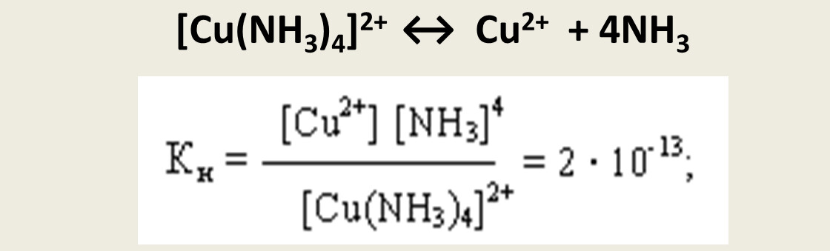
Competing equilibria and ligand exchange
In solution, several equilibria can coexist, including those involving different ligands, metal ions, or solvent molecules.
Ligand exchange reactions occur when one ligand replaces another on the metal center:
The direction of this equilibrium depends on:
The relative binding strength of the ligands (Kf values),
The concentrations of reactants and products,
pH and temperature conditions.
Such equilibria are crucial in biochemical systems (e.g., metal transport in enzymes) and industrial catalysis, where ligand substitution governs activity and selectivity.

Slide 8
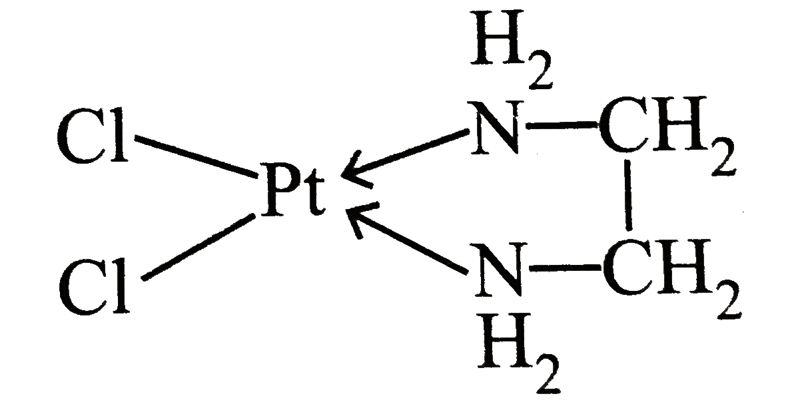
Chelate effect and entropy considerations
The chelate effect refers to the enhanced stability of complexes containing multidentate ligands (ligands that bind through several donor atoms).
For example, ethylenediamine (en) forms more stable complexes than ammonia, even though both have nitrogen donors.
This stability arises from two main factors:
Entropy increase — fewer free particles remain in solution after complex formation, making the process thermodynamically favorable.
Ring formation — chelation forms cyclic structures that are more resistant to dissociation.
The chelate effect shifts the equilibrium toward complex formation, often dramatically increasing stability constants by several orders of magnitude.
It is fundamental to the design of metal chelators, bioligands, and industrial catalysts.

Slide 9
Summary
Coordination equilibria represent the balance between metal ions, ligands, and complexes in solution.
The position of equilibrium depends on stability constants, metal–ligand properties, and solution conditions such as pH and ionic strength.
Hydrolysis, ligand exchange, and competing equilibria are essential processes that govern complex behavior.
The chelate effect and entropy contributions significantly enhance stability and drive complex formation.
A detailed understanding of equilibria in coordination compounds is critical for analytical chemistry, bioinorganic systems, environmental remediation, and catalysis.
The equilibria of coordination compounds in solution reflect a dynamic interplay of chemical forces and environmental conditions. By studying how metal ions, ligands, and solvents interact, chemists can predict and manipulate complex stability and reactivity across diverse scientific and industrial contexts.

Slide 10
Thank you for attention!

